Slide 1

RNS INSTITUTE OF TECHNOLOGY
DEPARTMENT OF MECHANICAL ENGINEERING
Presentation of
Mini Project Work titled
3D WIRE SHAPING MACHINE
By group no. 26
Akhil A 1RN18ME010
Anil R Kashyap 1RN18ME012
Anirudh S Betrabet 1RN18ME013
K S Kaustubha 1RN18ME041
Project Guide: Prof. Madhusudana H C, B.E, M.tech

Slide 2
Contents
Aim and Objectives
Theory
Methodology
Components required
Machine Images
Advantages, Disadvantages
Applications
Results
References

Slide 3
AIM:
To design and develop a 3D wire shaping machine which helps to shape wires in desired shapes.
OBJECTIVES:
To design the various components used in the machine.
To make it user friendly.
To make it 3D printing friendly.
To make it economical.

Slide 4
Theory
The enormous benefits of a wire-bending machine may not be immediately obvious, but that's because bent wires tend to be so ubiquitous that they're invisible. Shaped wires are used in baskets, chain link fences, shopping carts, fancy light fixtures, ornate gratings, stands, hooks, paperclips, springs, egg-beaters, and earrings. They are useful for creating structures and scaffolding. You can use a mixture of friction and welding to combine wires into incredibly complex shapes, or artistically useful designs like modernist chairs. It's a domain that, until now, has been out of reach for the independent crafter. This type of system has the potential to allow users to design or download a specific wire-based project and precisely create its individual components. And it creates the possibility to create skeletal frameworks for 3-D printers to build on, although this would require additional software and hardware development.
There are a lot of machines that are manufactured for bending wires. Our project involves designing a 3D wire shaping machine using an arduino board that can bend and shape a wire to the desired shape and dimensions

Slide 5
Literature Review
Sachin Yadav, et al. attempts to create a prototype capable of consistently bending a wire in 3D while avoiding collisions. In their journal published on June 2020, they say such a design can be obtained via automatic or semi-automatic curve feature extraction from a 3D shape. This makes the machine affordable and the wire bending technology goes beyond 2D plane and it is easily operable.
Naeem Siddik Petiwala, et al. proposed the prototype of a 3D printed wire bending machine using an arduino based controller which is flexible as well as capable to make bends for industrial applications. In their journal published on May 2021, they say that the accuracy of a bend made depends on many factors, but majorly on the expertise of the machine operator. Because of these limitation in manual wire bending, our project proposes a system that can efficiently bend and shape wires with the help of an arduino controller

Slide 6
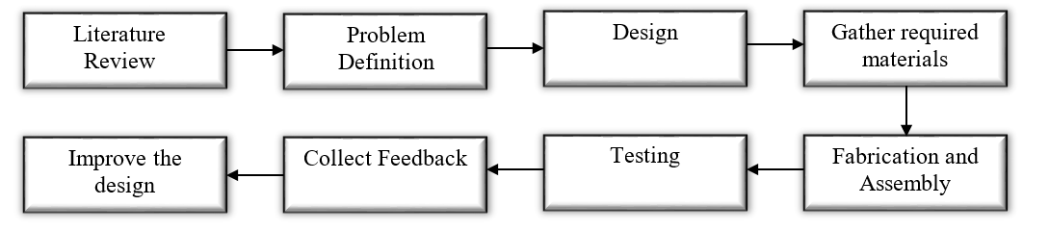
METHODOLOGY

Slide 7
1. Literature Review:
Reading papers from various researchers and design engineers on the current scenario and advancements made in the area of automatic wire bending machines.
2. Problem definition:
Understanding the need to design and develop an automatic wire bending machine.
3.Design:
Designing the various components such as gears, shafts, shaft couplers and bearing holders required for assembling the machine.

Slide 8
4. Gather the required material:
The next step is to gather the various components such as the hollow central shaft, bearings, stepper and servo motors and getting the other printable components printed.
5. Fabrication and assembly:
The required materials are then assembled according to the drawings.
6. Testing:
Various tests are conducted to check if the machine is able to bend the wire in the required shape and size
7. Collecting feedback and making the required improvements:
Feedback is collected from the project guide based on the tests conducted and the results achieved. Any required changes are made according to the inputs received from the guide.

Slide 9
WORKING
The wire is fed into the machine using a straightening mechanism consisting of grooved rollers and bearings. A stepper motor precisely controls the feed rate and the length of wire fed into the machine. The bending mechanism consists of a 2 stepper motors and a servo motor which are used to bend the wire into the required shape. One stepper motor (z-axis) is used to control the rotation of the central shaft which helps achieve the 3D forms while the other stepper motor (X-axis) is used to control the bending of the wire. The servo motor is used to drive a rack and pinion gear mechanism which is used the reset the stepper motor after the completion of a job. Gears are used to multiply the torque generated by the stepper motors into the torque required to bend the wire.

Slide 10
Components Required
3 stepper motors to precisely control the feed rate and the orientation of the bending mechanism.
Servo motor to reset the mechanism after a job is completed
Gears to convert the torque generated by the stepper motors to the torque to required to bend the wire.
Bearings to develop the straightening mechanism and ensure smooth rotation of the central shaft.
Arduino nano which is the brain of the machine.
Bearing holders for the bearings and plywood to hold everything in place

Slide 11
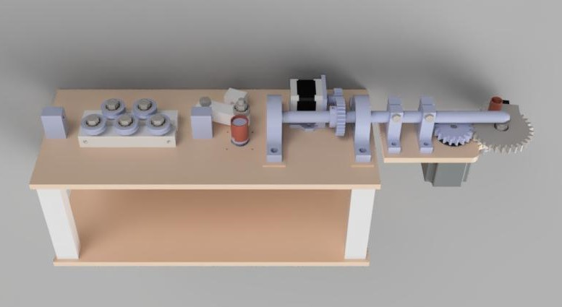
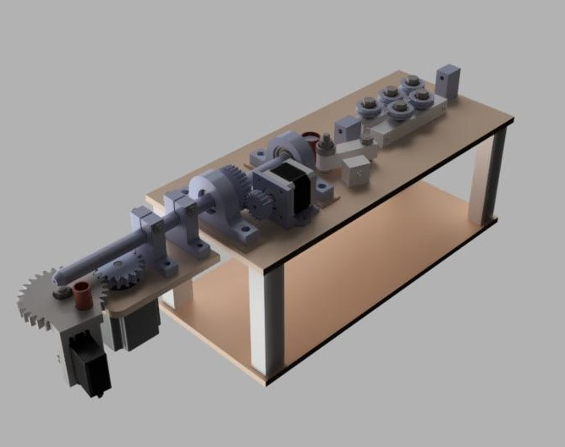
MACHINE IMAGES
FIG 1: Front View
FIG 2: Orthogrphic View

Slide 12
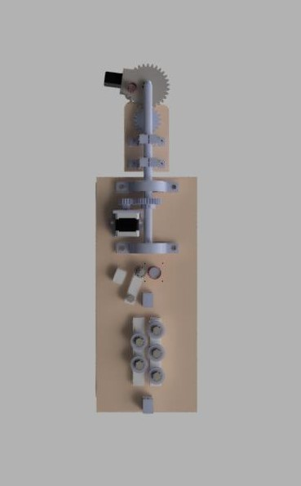
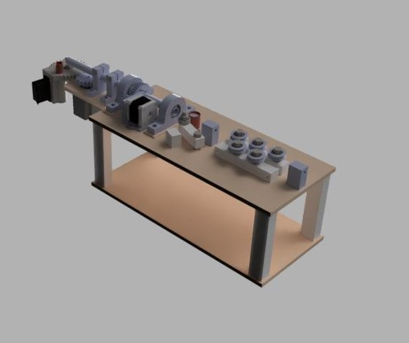
FIG 3: Top View
FIG 4: Orthographic View

Slide 13
ADVANTAGES:
Unique and intricate designs can be achieved.
Reduces human error.
High precision can be achieved.
Reduces cost and time
DISADVANTAGES:
Requires a skilled operator
Maintenance cost maybe high due to the use of gears.

Slide 14
APPLICATIONS
Can be used to create wire frameworks for 3d prints
Can be used to create intricate patterns
Can be used to create wire baskets

Slide 15
Results Expected:
Design and develop a 3D wire shaping machine that can easily and efficiently bend and shape wires into the desired shapes.
References:
Wamke P H, Seitz H, Warnke F, et al. Ceramic scaffolds produced by computer-assisted 3D Printing and sintering: Characterization and bio- compatibility investigations. Journal of Biomedical Materials Research Part B Applied Biomaterials 2010; 93(1): 212-217.
TANG Wenxian, ZHU Hui, ZHU Mengxiu, LI Qinfeng, ZHANG Jian “Research on Key Technology of Wire-Bending and Equipment Development” Management Science and Engineering Vol. 10, No. 1, 2016, pp. 14-20.
Chen Minghui, Yao Bin, Lin Rongkun, Lu Rusheng, “Research on 3D Modelling and Forming Simulation of Metal Wire” Advanced Materials Research Online: 2011-11-22ISSN: 1662-8985, Vols. 383-390, pp 6776-6783.
G. Antherieu, N. Connesson, D. Favier, P. Mozer, Y. Payan “Principle and Experimental Validation of a new Apparatus Allowing Large Deformation in Pure Bending: Application to thin Wire” Experimental Mechanics (2016) 56:475–482.
Hyun-Deog Cho, Sung-Jong Choi, “Gear Train Development for CNC Wire Bending Machine” Journal of the Korean Society of Manufacturing Process Engineers, Vol. 7 No. 4, pp.50-55 (2008. 12).

